Slide 1

Text-to-Speech Synthesis Methods

Slide 2
Contents
Text Analysis
Evolution of Speech Synthesis Methods
Early Speech Synthesis Approaches
Unit Selection Methods
TTS Future Needs

Slide 3
Text Analysis

Slide 4
Text Analysis
Introduction
Objective: Text analysis is a crucial preprocessing step in Text-to-Speech (TTS) synthesis, where the input text is analyzed and processed to extract linguistic information necessary for generating speech.
Role of Text Analysis:
Breaks the input text into manageable linguistic units (e.g., words, phonemes).
Provides information about word pronunciation, syntactic structure, and prosodic features required for speech synthesis.

Slide 5
Text Analysis
Why Perform Text Analysis?
Input Processing
Text analysis helps in segmenting and processing the input text into meaningful units, such as words or phonemes, for subsequent synthesis stages.
Linguistic Processing
Enables linguistic analysis to determine word pronunciation, stress patterns, and intonation contours based on syntactic and semantic context.
Speech Synthesis
Serves as the foundation for subsequent stages of TTS synthesis, including prosody generation, phoneme synthesis, and waveform generation.

Slide 6
Text Analysis
Algorithm Formulation
Tokenization
The input text is tokenized to split it into individual words, punctuation marks, and other linguistic units.
Lexical Analysis
Words are looked up in a lexicon (dictionary) to retrieve their corresponding phonetic transcriptions and linguistic properties (e.g., part-of-speech tags).
Syntactic Parsing
The grammatical structure of sentences is analyzed to identify syntactic categories (e.g., noun phrases, verb phrases) and dependencies.

Slide 7
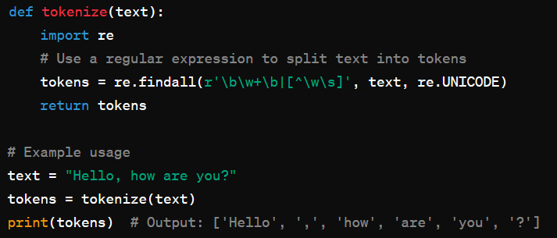
Text Analysis
Algorithm Formulation
Tokenization - Examples
Use whitespace and punctuation as delimiters to split the text.
Handle special cases such as contractions (e.g., "can't" → ["can", "'t"]).
Input: "Hello, how are you?"
Output: ["Hello", ",", "how", "are", "you", "?"]

Slide 8
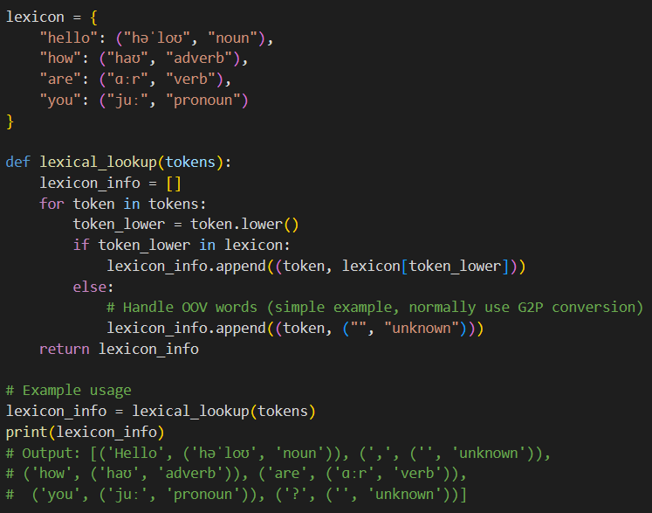
Text Analysis
Algorithm Formulation
Lexical Analysis - Examples
Use a pre-built lexicon that contains mappings of words to their phonetic transcriptions and part-of-speech (POS) tags.
Handle out-of-vocabulary (OOV) words by using grapheme-to-phoneme (G2P) conversion or fallback mechanisms.

Slide 9
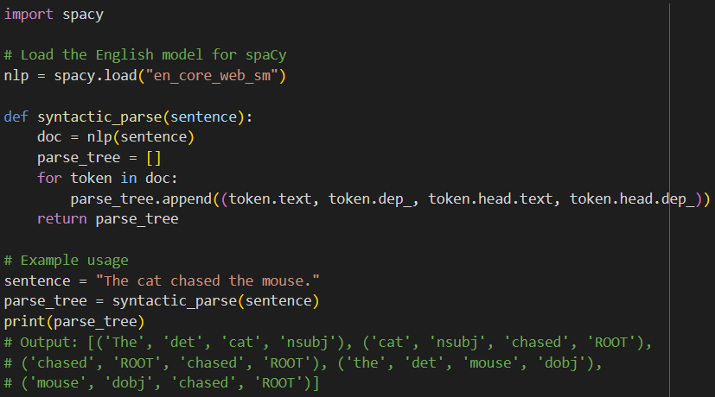
Text Analysis
Algorithm Formulation
Syntactic Parsing - Examples
Use a syntactic parser (e.g., based on context-free grammar or dependency parsing) to generate parse trees.
Identify and label syntactic elements and their relationships within the sentence.
Input: "The cat chased the mouse."
Output: Parse Tree
(S (NP (DT The) (NN cat)) (VP (VBD chased) (NP (DT the) (NN mouse))))

Slide 10
Text Analysis
Practical Assignment
Implementing Text Analysis for TTS
Task: Implement Python functions for TTS tokenization, lexical analysis, and syntactic parsing.
Steps:
Implement a tokenizer function to split input text into tokens (words, punctuation).
Develop a lexicon lookup function to retrieve phonetic transcriptions and linguistic properties (e.g., part-of-speech) for words.
Create a syntactic parsing function to analyze the grammatical structure of sentences and generate parse trees.

Slide 11
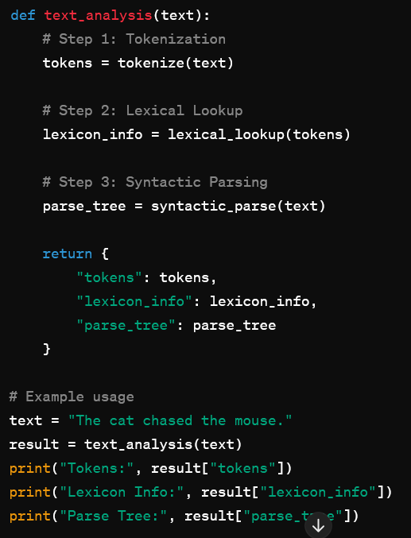
Text Analysis
Practical Assignment

Slide 12
Evolution of Speech Synthesis Methods

Slide 13
Evolution of Speech Synthesis Methods
Early Methods - Formant Synthesis
Formulation
Formant synthesis models the human vocal tract.
It generates speech by creating waveforms based on the formant frequencies (resonant frequencies of the vocal tract).
Explanation
Utilizes control parameters such as pitch, volume, and formant frequencies.
Pros: High control over speech parameters.
Cons: Often produces robotic and unnatural-sounding speech.
Example
Linear Predictive Coding (LPC) is a common formant synthesis technique.

Slide 14
Evolution of Speech Synthesis Methods
Concatenative Synthesis
Formulation
Uses prerecorded speech units (e.g., phonemes, syllables) and concatenates them to form complete utterances.
Explanation
Units are stored in a database and selected based on linguistic context.
Pros: Can produce high-quality, natural-sounding speech.
Cons: It requires a large database and can cause issues with smooth transitions between units.
Example
Unit selection synthesis, where the best matching units are selected based on context.

Slide 15
Evolution of Speech Synthesis Methods
Statistical Parametric Synthesis
Formulation
Models the speech signal using statistical methods, typically Gaussian Mixture Models (GMMs) or Hidden Markov Models (HMMs).
Explanation
Parameters such as spectral envelope, pitch, and duration are generated statistically.
Pros: Smaller footprint compared to concatenative synthesis and offers flexibility.
Cons: May produce less natural-sounding speech compared to unit selection methods.
Example
HTS (HMM-based Speech Synthesis System).

Slide 16
Evolution of Speech Synthesis Methods
Neural Network-Based Synthesis
Formulation
Uses deep learning models to generate speech from text, often employing neural networks like Recurrent Neural Networks (RNNs) or Convolutional Neural Networks (CNNs).
Explanation
Pros: High-quality, natural-sounding speech with the ability to learn from data directly.
Cons: Requires large amounts of data and computational resources.
Example
WaveNet, a deep generative model developed by DeepMind.

Slide 17
Evolution of Speech Synthesis Methods
End-to-End Synthesis Models
Formulation
Integrates all components of the TTS pipeline into a single neural network model, typically using architectures like Tacotron and FastSpeech.
Explanation
Simplifies the TTS pipeline and reduces the need for extensive feature engineering.
Pros: Produces highly natural and expressive speech.
Cons: Still computationally intensive and data-hungry.
Example
Tacotron 2, which uses a sequence-to-sequence model with attention mechanisms.

Slide 18
Evolution of Speech Synthesis Methods
Implementing a Basic TTS System
Objective: Develop a simple TTS system using a neural network-based approach.
Steps
Data Preparation: Load and preprocess text and audio data.
Model Training: Train a neural network model on the prepared data.
Text-to-Speech Conversion: Use the trained model to convert text input to speech output.

Slide 19
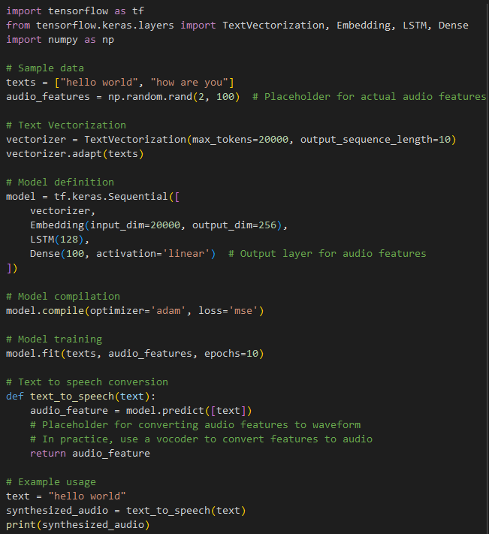
Evolution of Speech Synthesis Methods
Implementing a Basic TTS System

Slide 20
Evolution of Speech Synthesis Methods
Summary
The evolution of speech synthesis methods has progressed from formant synthesis to advanced neural network-based models.
Each method has its strengths and limitations, influencing the choice of technology based on application requirements.
Future Trends
Continued improvements in neural network architectures and training techniques.
Increased focus on making TTS systems more data-efficient and computationally feasible.

Slide 21
Early Speech Synthesis Approaches

Slide 22
Early Speech Synthesis Approaches
Introduction
Overview
Early speech synthesis methods aimed to replicate human speech using various techniques.
These methods laid the foundation for modern Text-to-Speech (TTS) systems.

Slide 23
Early Speech Synthesis Approaches
Formant Synthesis
Formulation
Models the human vocal tract by simulating formants, the resonant frequencies of the vocal tract.
Formulation
Speech is generated by creating waveforms based on the positions and amplitudes of formants.
Control parameters include pitch, volume, and formant frequencies.
Often uses Linear Predictive Coding (LPC) for analysis and synthesis.
Pros/Cons
High control over speech parameters.
Can generate speech from text with a relatively small dataset.
Often produces robotic and unnatural-sounding speech.

Slide 24
Early Speech Synthesis Approaches
Articulatory Synthesis
Formulation
Simulates the physical processes of the human vocal tract, including the movements of the tongue, lips, and other articulators.
Formulation
Uses detailed models of the vocal tract anatomy and physiology.
Generates speech by modeling the airflow and pressure through the vocal tract.
Pros/Cons
Produces more natural-sounding speech by accurately simulating human speech production mechanisms.
Computationally complex and requires detailed anatomical data.
Example
Models developed by researchers like Gunnar Fant.

Slide 25
Early Speech Synthesis Approaches
Articulatory Synthesis
Formulation
Simulates the physical processes of the human vocal tract, including the movements of the tongue, lips, and other articulators.
Formulation
Uses detailed models of the vocal tract anatomy and physiology.
Generates speech by modeling the airflow and pressure through the vocal tract.
Pros/Cons
Produces more natural-sounding speech by accurately simulating human speech production mechanisms.
Computationally complex and requires detailed anatomical data.
Example
Models developed by researchers like Gunnar Fant.

Slide 26
Early Speech Synthesis Approaches
Implementing a Basic Formant Synthesis
Objective: Develop a simple formant synthesis system to generate vowel sounds.
Steps:
Define the formant frequencies for different vowels.
Generate the waveform for each vowel using sine waves at the formant frequencies.
Combine the waveforms to create a speech signal.
Input: Text specifying vowel sounds.
Output: Audio waveform representing the synthesized vowels.

Slide 27
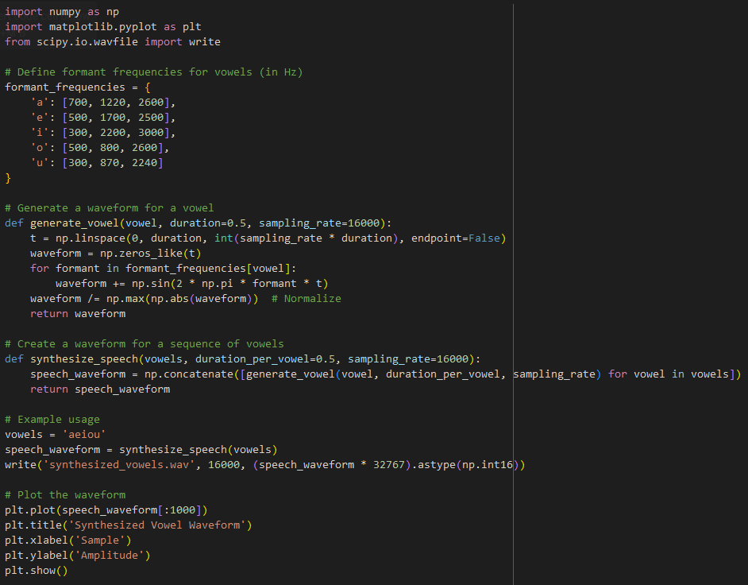
Early Speech Synthesis Approaches
Implementing a Basic Formant Synthesis

Slide 28
Early Speech Synthesis Approaches
Summary
Early speech synthesis approaches include formant synthesis, articulatory synthesis, and concatenative synthesis.
Each method has its advantages and challenges, influencing the development of modern TTS systems.

Slide 29
Unit Selection Methods

Slide 30
Unit Selection Methods
Introduction
Overview
Unit selection synthesis is a widely used method in Text-to-Speech (TTS) systems.
It involves selecting and concatenating prerecorded speech units from a large database to generate natural-sounding speech.
Key Points
Focuses on high-quality, natural-sounding output.
Requires a comprehensive database of speech units.

Slide 31
Unit Selection Methods
Formulation of Unit Selection Methods
Database Creation
Record a large corpus of speech.
Segment the speech into units (e.g., phonemes, diphones, syllables).
Feature Extraction
Extract features from each unit (e.g., pitch, duration, energy).
Unit Selection
For a given input text, select the best-matching units based on linguistic and prosodic context.
Use dynamic programming or other optimization techniques to find the best sequence of units.
Concatenation
Concatenate the selected units smoothly to produce continuous speech

Slide 32
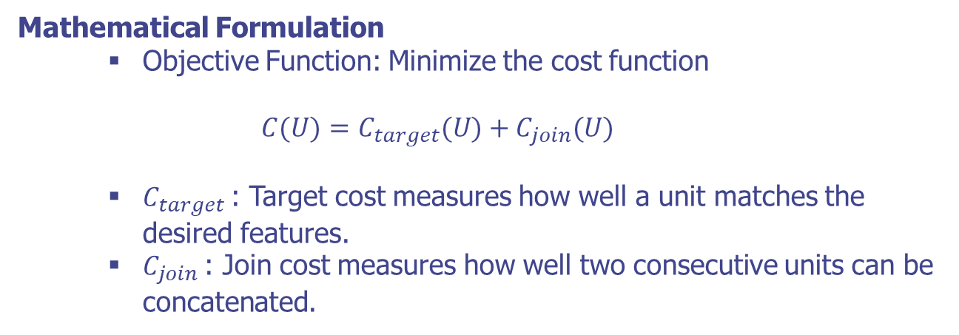
Unit Selection Methods
Formulation of Unit Selection Methods
Mathematical Formulation
Objective Function: Minimize the cost function
$$C(U)=C_{target}(U)+C_{join}(U)$$
$C_{target}$: Target cost measures how well a unit matches the desired features.
$C_{join}$: Join cost measures how well two consecutive units can be concatenated.

Slide 33
Unit Selection Methods
Explanation of Unit Selection Methods
Unit Database
Contains various speech units to cover different phonetic and prosodic contexts.
Units are annotated with features like pitch, duration, and energy.
Target Cost
Evaluates the suitability of a unit for a given context.
Based on linguistic features (e.g., phoneme identity, part-of-speech).
Join Cost
Evaluate the smoothness of concatenation between two units.
Based on acoustic features (e.g., pitch continuity, spectral similarity).
Selection Process
Dynamic programming is often used to find the optimal unit sequence that minimizes the total cost.

Slide 34
Unit Selection Methods
Implementing a Basic Unit Selection System
Objective: Develop a simple unit selection TTS system.
Steps:
Create a small unit database.
Implement feature extraction.
Implement unit selection and concatenation.
Input: Text string (input text).
Output: Audio file (synthesized speech).

Slide 35
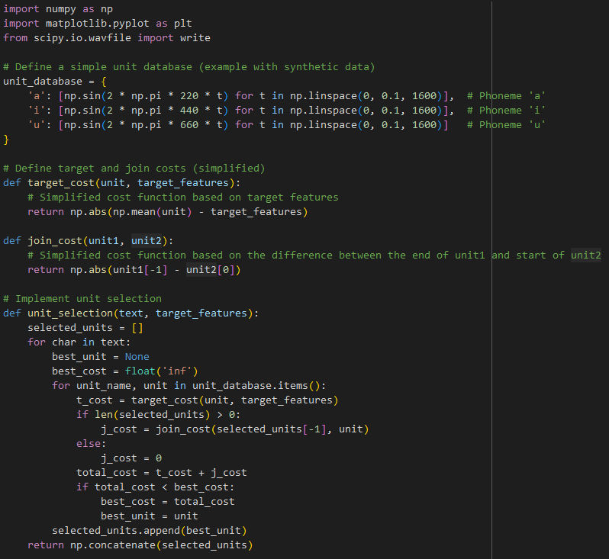
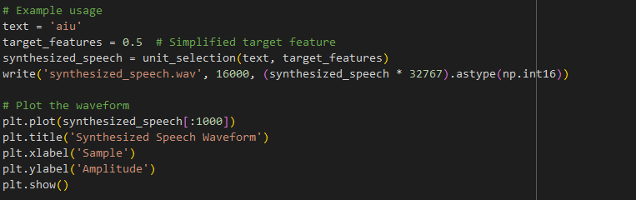
Unit Selection Methods
Implementing a Basic Unit Selection System

Slide 36
TTS Future Needs

Slide 37
TTS Future Needs
Introduction
Overview
Despite significant advancements, TTS technology continues to evolve.
Identifying future needs is crucial to address current limitations and enhance the naturalness and versatility of TTS systems.

Slide 38
TTS Future Needs
Introduction
Overview
Despite significant advancements, TTS technology continues to evolve.
Identifying future needs is crucial to address current limitations and enhance the naturalness and versatility of TTS systems.

Slide 39
TTS Future Needs
Current Limitations
Challenges
Naturalness: TTS systems often produce robotic or unnatural-sounding speech.
Expressiveness: Limited ability to convey emotion and intonation.
Efficiency: High computational and data requirements.
Impact
Hinders user experience in applications like virtual assistants, accessibility tools, and automated customer service.

Slide 40
TTS Future Needs
Areas of Improvement
Challenges
Speech Quality: Enhance the naturalness and intelligibility of synthesized speech.
Expressiveness: Enable TTS systems to convey emotions and nuances in speech.
Efficiency: Reduce computational resources and data requirements for TTS.
Approaches
Integration of advanced machine learning techniques.
Research on linguistics and phonetics for better modeling.

Slide 41
TTS Future Needs
Implementing an Emotion-Aware TTS System
Objective: Develop a basic TTS system capable of synthesizing speech with different emotional tones.
Steps
Collect emotional speech data.
Implement emotion-aware feature extraction.
Train a model to generate emotional speech.
Input: Text string and emotion label.
Output: Audio file with synthesized speech.

Slide 42
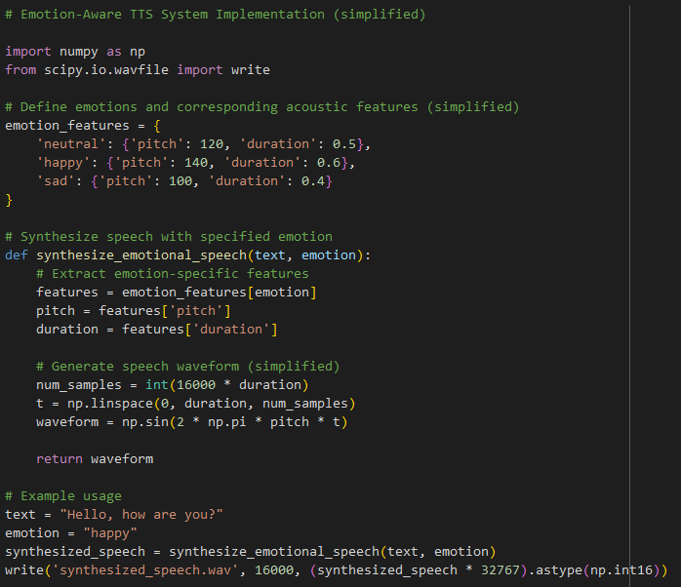
TTS Future Needs
Implementing an Emotion-Aware TTS System

Slide 43
TTS Future Needs
Summary
Future needs in TTS synthesis focus on enhancing speech quality, expressiveness, and efficiency.
Advancements in machine learning and signal processing will drive innovation in TTS.
Improved TTS systems will enhance user experience in various applications and domains.

Slide 44
Q & A

